Slide 1
Learning Features and Parts for Fine-Grained Recognition
Authors: Jonathan Krause, Timnit Gebru, Jia Deng , Li-Jia Li, Li Fei-Fei
ICPR, 2014
Presented by: Paritosh

Slide 2
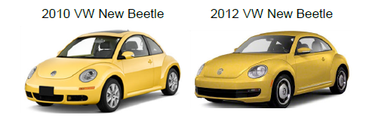
Problem addressed
Authors address the problem of Fine-Grained Recognition
Fine-Grained Recognition – distinguish at subordinate level – intraclass classification
Examples: Bird species, car models, cat breeds, etc.
what specie that bird belongs to? Is that car Mclaren P1 or Mclaren MP4-12C ?
(All the images are taken from the paper being presented)

Slide 3
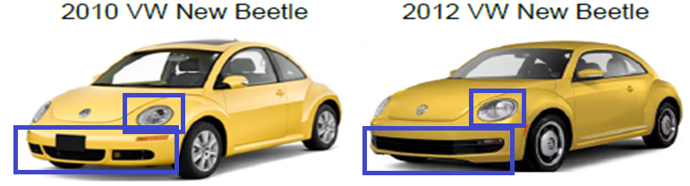
How do we do Fine-Grained (FG) recognition?
By noticing distinguishing parts – parts which are different
In the previous example grills and lights are some parts that help in distinguishing, visually

Slide 4
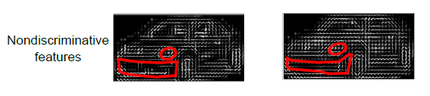
Why not use popular descriptors ?
Popular descriptors:
SIFT
HOG
They are not expressive enough
Doesn’t, reliably, capture intricacies
Almost similar
HOG patterns

Slide 5
Go for very expressive framework
Convolutional Neural Networks or ConvNets or CNN’s are the State-of-the-Art
Very rich descriptions
Highly scalable
Consistently, best performance on the ImageNet

Slide 6
Deep Learning
Deep learning is a kind of hierarchical learning paradigm
For example, a neural network with 5 hidden layers; shallow (typical) neural nets are the ones with 1 or 2 hidden layers
Layers and their learned representation:
Input layer – raw data
Hidden layer 1 – learns very low level features from raw data - edges can be a good example
Hidden layer 2 – learns features that are of higher level than Hidden layer 1 – may be learns to identify squares
Level of features increase in a similar fashion as we go on to subsequent hidden layers

Slide 7
Deep Learning – CNN’s
CNN’s are deep learners
Combination of
Input layer
Convolutional layers
Activation layers (ReLU layers)
Sub-sampling/pooling layers
Fully connected layers
Contains several of these layers

Slide 8
CNN’s

Slide 9
back to the paper… The Big picture
Find discriminative parts
Describe these parts using rich descriptions, like the ones obtained from the CNN’s
Rich descriptions should be able to capture the subtle differences
Train a multiclass classifier

Slide 10
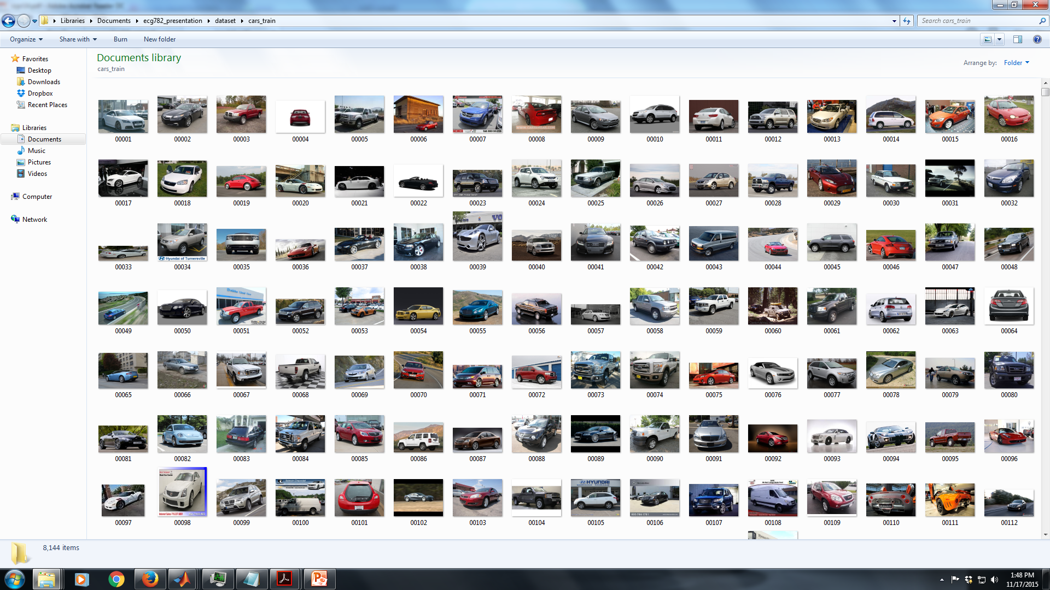
Dataset, ‘Cars’ - some images

Slide 11
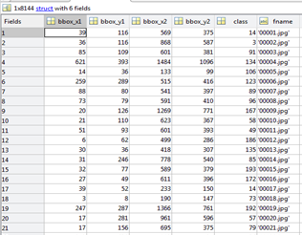
Dataset (annotations - BB’s, labels)

Slide 12
The pipeline for FG recognition
Training:
Step 1: Detect parts using trained part detectors
Step 2: determine the appearance of these parts using CNN’s features. Concatenate these features. Concatenated features form what is known as ELLF (Ensemble of Localized Learned Features)
Step 3: Train Linear SVM’s for classification

Slide 13
Step 1: Part discovery & detection
For the purpose of scalability, go for unsupervised learning
Remove the human intervention (in the form of annotations) from the loop
Observation made by the authors:
Objects with same pose can be discovered using local low-level cues
Assumptions:
Images within a set are well aligned
Implies that same parts will have similar locations – for example, given a small set of car images, probability of finding wheels, grills, etc, in similar positions, is very high

Slide 14
Part discovery contd…
Discovering aligned images
Step 1: Randomly pick a seed image
Step 2: Perform Grabcut – removes background efficiently – we are left with just car, no background
Step 3: Find HOG features for the car images
Step 4: find nearest neighbors, based on HOG features
Repeat the above process multiple times
Results in set of images with more or less same pose

Slide 15
Part selection
Step 1: randomly sample large no. of regions of various sizes
Step 2: select parts which high variance in their HOG features
Step 3: keep the parts which have high variance in HOG features (these are the ones useful for discrimination)
Step 4: get rid of redundant parts
At last, they have 10 parts, started with 5000

Slide 16
Detector learning
Equivalently, find template that minimize hinge loss (a loss function) – difference between true label and the outcome of the classifier
Essentially, this is telling the detector, what is positive and what is negative, based on HOG features
We start this learning under the assumption that images are well aligned
Once trained, we retrain, only this time we relax the assumption that images are well aligned
We do this by allowing the usage of true positive patch location – because, remember, we assumed that the parts will be occupying similar positions and not the same
If true positions are too far away, they are penalized
In effect, this is Gaussian distribution about the original location (the one under the well alignment assumption)
Helps in neglecting parts with appearance similar to positive patches

Slide 17
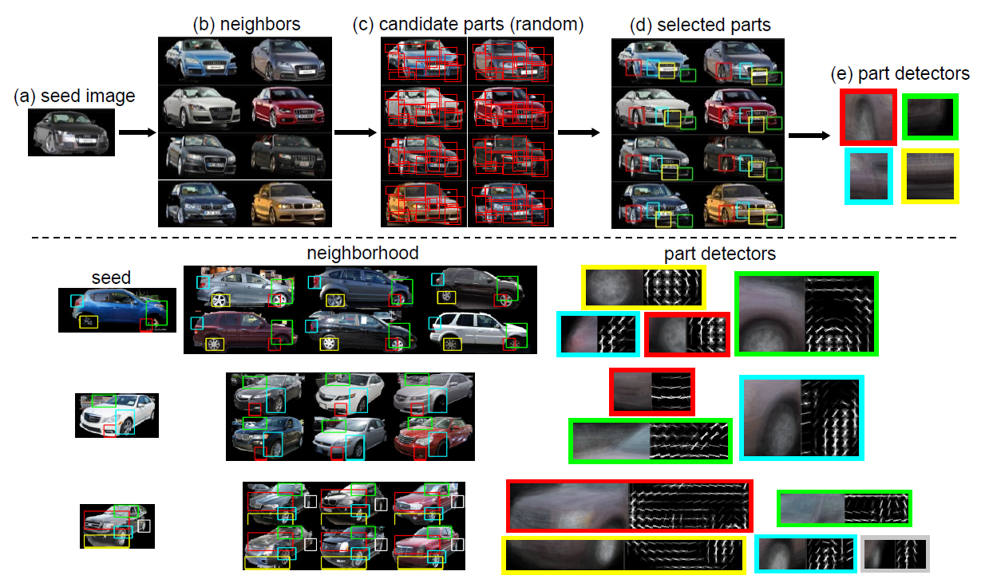

Slide 18
Ensemble of parts
Remember that there are multiple parts as an outcome part discovery
Learn detector for every part
Consequently, we would have a collection pf part detector, each detecting a specific – in cars, wheels, grills, etc.
Authors call this Ensemble of parts.

Slide 19
Feature Learning
Take AlexNet, CNN implementation of Alex Krizhevsky et al.
Tweak (for details refer the paper) to account for smaller dataset
Train the modified CNN – inputs are whole images from the dataset
Retain only the first two convolutional layers
Unlike regular CNN’s which do pooling at fixed positions, we do max pooling, of the descriptors, in the regions marked by bounding boxes (BB’s), which are obtained from part detectors
This yields us Ensemble of Local Learned Features (ELLF)
Feed these ELLF’s to a linear SVM – final classifier
Overfitting is taken care of

Slide 20
Experiments
Some of intuitive details were included in the previous slides
For minute details, CNN parameters and their tuning, please refer the paper
One important observation regarding number of parts used in ELLF features (different from part discovery)
100 parts is where ELLF significantly gets ahead of CNN
1000 parts – ELLF almost reaches saturation
Performance is hurt when GrabCut performs poorly

